Slide 1




Generative Artificial Intelligence
Paul Dubois
Info@Lèze

Slide 2
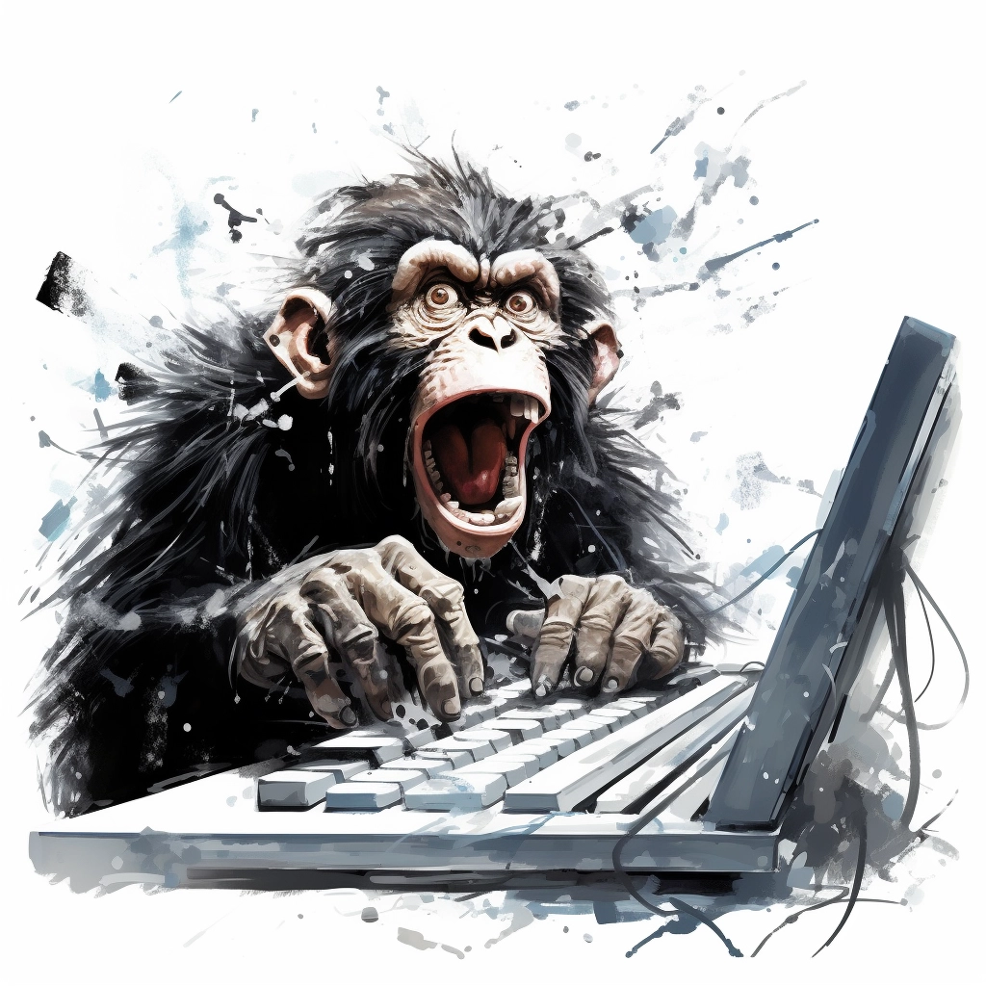
Creating *new* Words

Slide 3
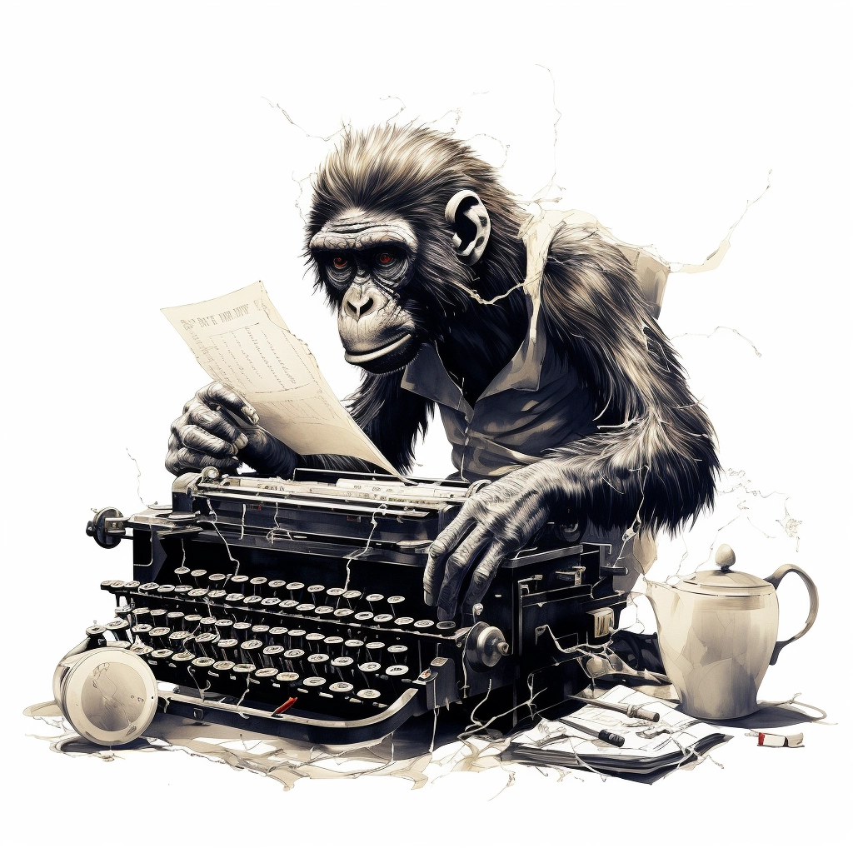
Method #1:
Randomly type on a keyboard

Slide 4
Predict letters

Slide 5
Generator vs Discriminator

Slide 6
Denoising

